Slide 1
Toyota Practicum
Background Information

Slide 2
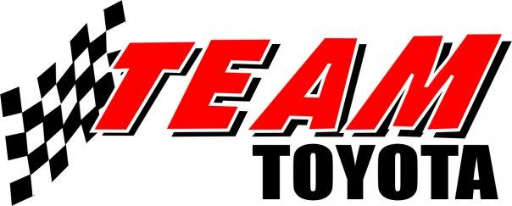
Team Toyota
A.J. Ruiz, Ambarish Karole, Grace Lee, Harikumar Sulochana, Hyo Jeong

Slide 3
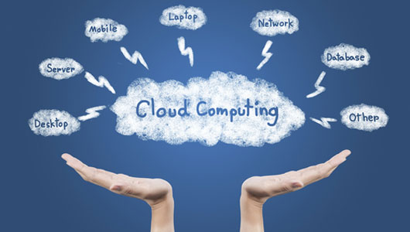
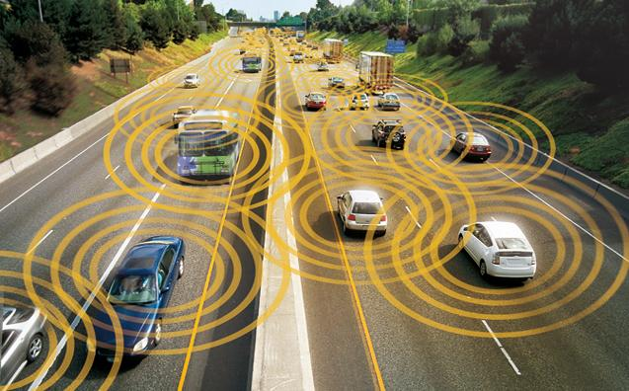
Project Background
Traditional Cloud computing is great but not Real time
There are significant real-time constraints that may limit the use of traditional
cloud APIs and services for collaborative data sharing and processing.
Notes:
Brief Context: about this project (short introduction to the problem we are trying to solve)
Traditional Cloud computing is great but not Real time
There are significant real-time constraints that may limit the use of traditional cloud APIs and services for collaborative data sharing and processing.

Slide 4

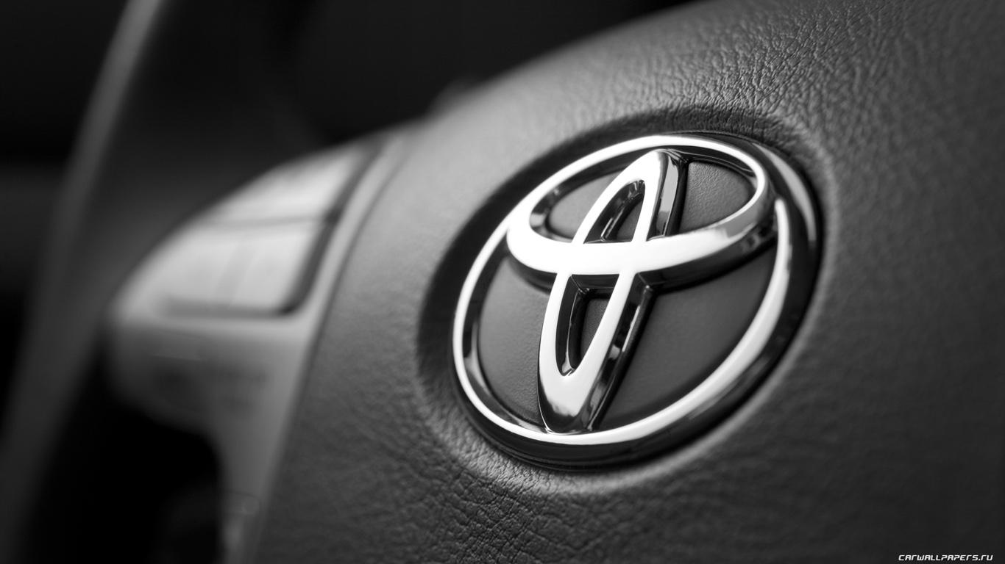
Project Background: Toyota: Development of Collaborative
Vehicular Cloud Services
A promising approach is for a group of vehicles to create their own mobile cloud
Notes:
Brief Context: about this project (short introduction to the problem we are trying to solve)
Traditional Cloud computing is great but not Real time
There are significant real-time constraints that may limit the use of traditional cloud APIs and services for collaborative data sharing and processing.

Slide 5
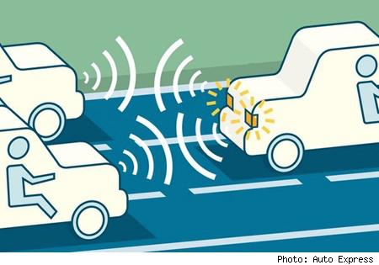
Project Background- Mobile Cloud Computing
Driven by increasing storage and processing capacity of mobiles and the need to communicate and keep locally relevant content on the mobiles instead of uploading to cloud
Each vehicle is a node in the mobile cloud. Cars offer higher processing speed and storage
Notes:
2. difference between cloud computing
5. e.g as well

Slide 6

Project Background- Mobile Cloud Computing
Why MCC (need for MCC):
Advantages of mobile mini-clouds over global cloud are reduced communication delay, reduced spectrum costs, and amply expanded range of applications.
Mobile devices are improving in storage and processing capabilities, so network latency can be reduced by offloading the cloud processing to local nodes.
Mobile agents can be both users as well as service providers
Mobile node can interact and collaborate to sense environment , process data ,
propagate results and more generally share resources.
Notes:
2. difference between cloud computing
5. e.g as well

Slide 7
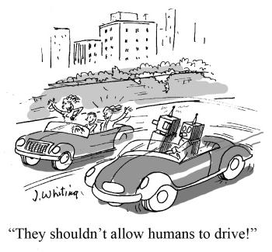
Project Background- Mobile Cloud Computing
We will build a Proof Of Concept for a middle tier application that will enable us to provide infrastructure for supporting these different use cases.
Toyota Use cases
TUS 1 Driver Safety - Collaborative sensing ( negotiating a blind turn or backing out of parking space)
TUS 2 Driver Safety - Merge assistant
TUS 3- Collaborative services - Navigation
TUS 4- Collaborative services- Emergency assistance
TUS 5 - Co-ordinated driving/platooning
TUS 6 - In Vehicle entertainment - Shared content markets
Notes:
2. difference between cloud computing
5. e.g as well

Slide 8


State of the Art
Notes:
Collaborative services
In-vehicle entertainment
Mobile vehicles are both cloud users and service providers (P2P). This content distribution allows data aggregation among many vehicles to compute data scattered across many different locations.
Unlimited ability to collect sensor information
Advanced Driving safety applications -

Slide 9
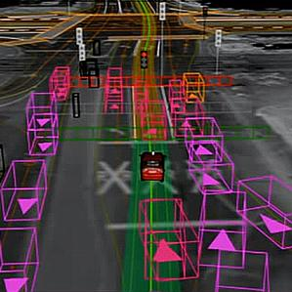
State of the Art
Notes:
Coordinated driving
Intelligent transportation
Local relevance of information
Traffic management
Urban sensing and surveillance

Slide 10
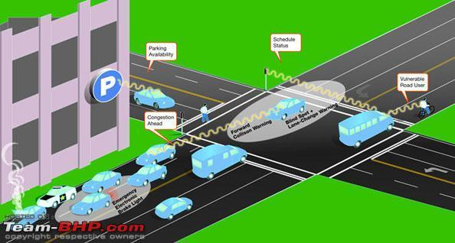
State of the Art
Notes:
Driving safety
Bus arrival forecasting
Parking space discovery
Localization of weather phenomena
Distributed pollution detection\
Mobile advertising

Slide 11


What’s the gap?
Privacy and Security
Notes:
Privacy and Security
protecting the data and allowing users to decide which data to expose and which to not expose.

Slide 12
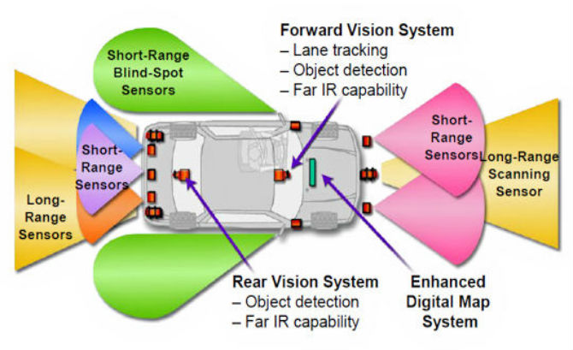
What’s the gap?
Sensor filtering and aggregation
Notes:
Sensor filtering and aggregation
There is lot of data coming in from the sensors and it needs to be selectively processed and aggregated.

Slide 13
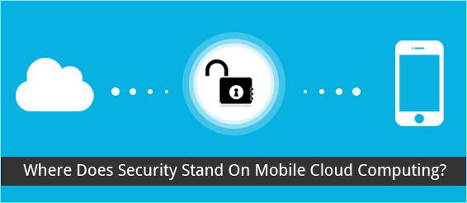
What’s the gap?
Secure Networking
Notes:
Secure Networking
Lack of central authority means distribution of content needs to be managed via trust management that relies on mobile cloud structure.

Slide 14
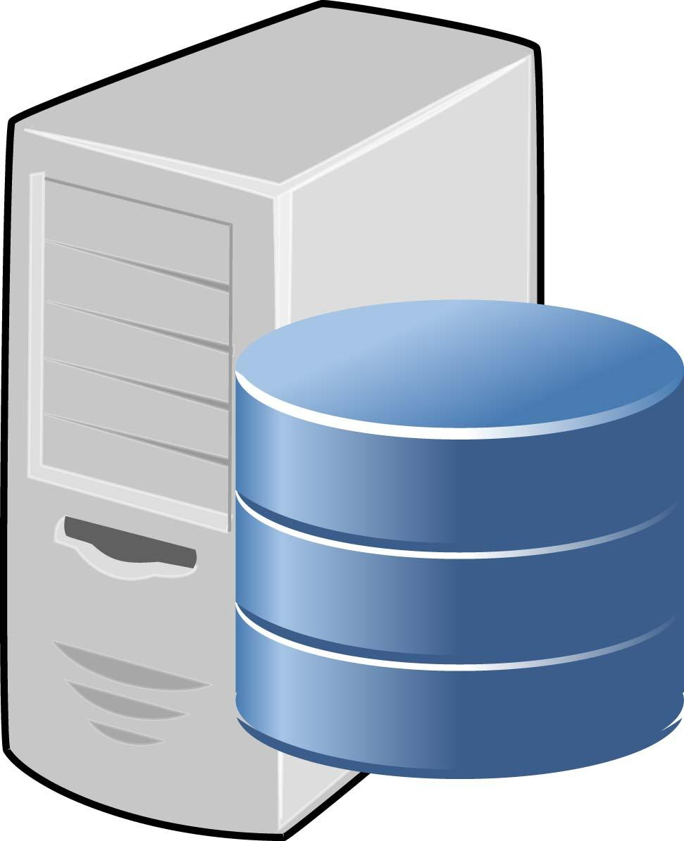

What’s the gap?
Specialized Server, file system, networking, and memcache for mobile apps.
Notes:
Server, file system, networking, and memcache technologies should all be specialized for mobile applications
connectivity (can we ensure the connectivity all the time?)

Slide 15
What’s the gap?
Lots of mobile cloud computing services that needs to be provided by the Cloud Providers
platform service (computing, storage, database for mobile)
application service (presence service for location, etc)
context rich service (data mining of mobile data, recommendations, etc)
support for collaborative applications
Extract collective trends from large group of users.

Slide 16
Preliminary Study
Main Features
Feature 1: Vehicle can request other vehicles to process information
Feature 2: Vehicle can request other Vehicles for information
Image Source: http://automobileinnovations.blogspot.com
Notes:
Image Source: http://automobileinnovations.blogspot.com

Slide 17


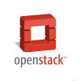
Preliminary Study
Third-party software being evaluated
Apache Storm
Hyrax
OpenStack

Slide 18
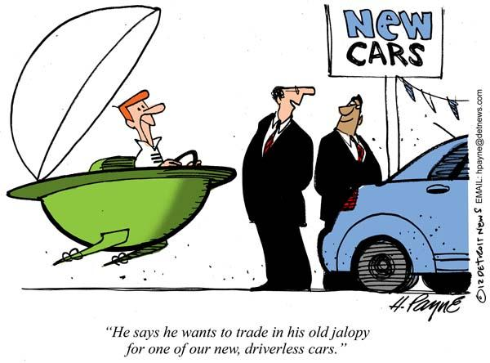
Preliminary Study - Apache Storm
Apache Storm
Open Source
Distributed Real time computing
Scalable
Robust and fault-tolerant
No Data loss
Programming Language Agnostic

Slide 19
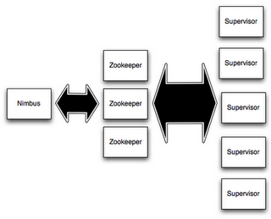
Preliminary Study - Apache Storm
Storm Cluster

Slide 20
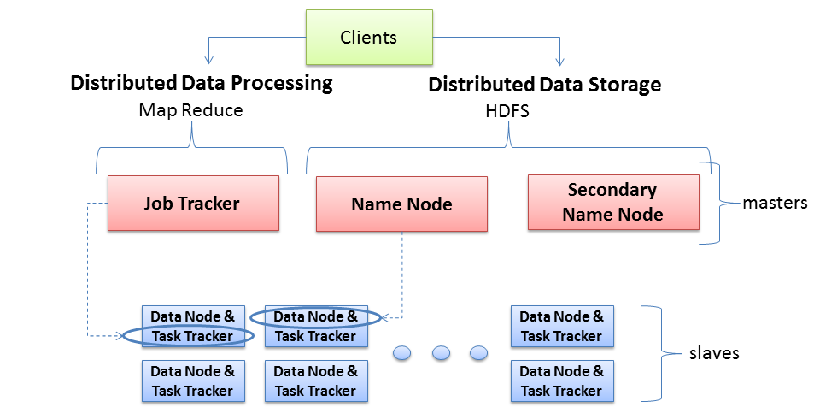
Preliminary Study - Hyrax
Typical Hadoop Cluster Configuration

Slide 21
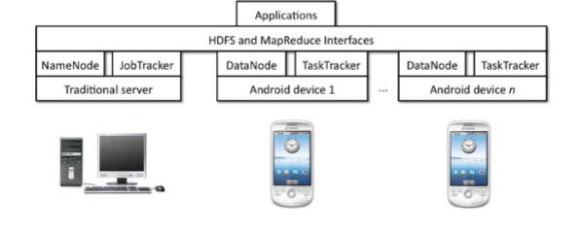
Preliminary Study - Hyrax
Hyrax Hardware and Software Layers

Slide 22
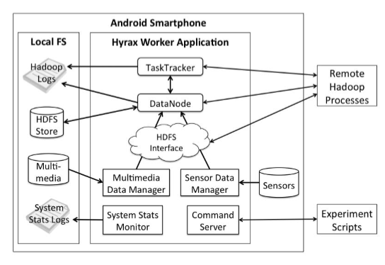
Preliminary Study - Hyrax
Hyrax Worker Application Component Interaction Diagram

Slide 23
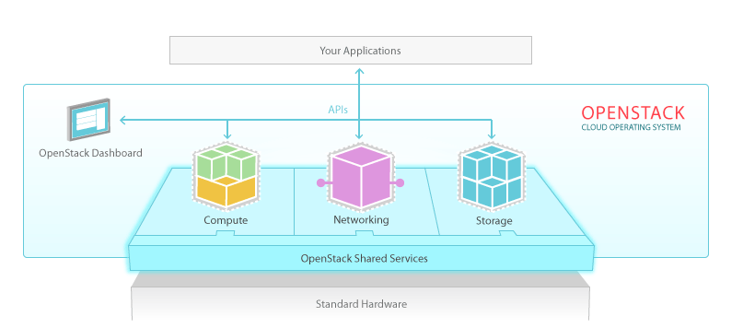
Preliminary Study - OpenStack
OpenStack
Notes:
OpenStack is an open source cloud computing platform. It provides infrastructure to do distributed processing, a solution for flexible storage, and provides networking resources. It allows you to provide cloud computing services running on the set of machines of your choice (data center, many laptops, etc).

Slide 24
Preliminary Study - OpenStack
Compute
Security (API with rate limiting and authentication)
Flexibility
Distributed and asynchronous architecture
Virtual Machine (VM) image management
Security Groups
Notes:
API with rate limiting and authentication
Designed for automation and security (to make it easy for you to manage who has access to compute resources and prevent users from impacting each other with excessive API utilization)
Distributed and asynchronous architecture
Virtual Machine (VM) image management
Easily store, import, share, and query images (to make it easy for you to spin up new standardized VMs)
Security Groups
Flexibility to assign and control access to VM instances by creating separation between resource pools

Slide 25
Preliminary Study - OpenStack
Storage
Data Redundancy protects from failures
Easily scalable.
No central Database
Can handle lot of small random reads and writes
Notes:
Data redundancy protects from failures.
Easily scalable (account/container/object structure).
No Central Database.
High performance, no bottlenecks.
Can handle lots of small random reads and writes
*** Toyota can utilize OpenStack storage to store arbitraily large big-data collected from sensors. The query will be fast because there is no central database and it can use the object storage for different types of data. Also, it is backed up so very little chance of losing data.

Slide 26
Preliminary Study - OpenStack
Network
Users can create their own networks, control traffic, and connect servers and devices to one or more networks.
OpenStack Networking has an extension framework allowing additional network services, such as intrusion detection systems (IDS), load balancing, firewalls and virtual private networks (VPN) to be deployed and managed.

Slide 27

Proposed methods
Finalize the decision on which technology stack we will use based on the following factors
Distributed computing
Distributed Querying
Privacy & Security
Ease of integration
Dynamic topology creations (nodes joining and dropping out)
Platform independent
… (more required features)

Slide 28


Proposed methods
2. Integration between different stacks and build plug-ins using their API
3. Create a prototype that demonstrates distributed data processing and querying of distributed data storage.

Slide 29

Questions?
Questions?

